Slide 1

Design and Analysis of 8x1 Multiplexer Using CMOS and CNTFET Technologies
Team Members:
1) L.Kruti -21071A04P6
2) M.Bhanu Chandhar-21071A04P7
3) SK.Aafrin -21071A04R9
Project Guides :
Dr. L Dharma Teja, Asst. Prof, ECE
Dr. V. Priyanka Brahmaiah, Asst. Prof, ECE

Slide 2
PREVIOUS REVIEW COMMENTS
We have designed a 3 bit binary multiplier using domino logic and static cmos technologies and compared the power results.
The suggestion given was to design an 8 bit multiplier and analyse the leakage power.
Now, we have designed an 8x1 multiplexer using various CMOS logics like domino, dynamic and transmission gates.
We have also designed an 8x1 multiplexer using CNTFET technology.

Slide 3
PROBLEM STATEMENT
Traditional CMOS logic often faces challenges such as slower computation speeds and higher power consumption.
Domino logic, known for its high-speed operation and reduced leakage power , presents a potential improvement.
The task is to design an 8x1 multiplexer (MUX) that utilizes domino logic to enhance both speed and power efficiency, while addressing the complexities and timing issues inherent to dynamic logic circuits.
By integrating Carbon Nanotube Field-Effect Transistor (CNTFET) technology, the goal is to demonstrate that this advanced approach can provide substantial performance benefits over conventional static CMOS designs, particularly in terms of switching speed and power consumption.

Slide 4
ABSTRACT
This project focuses on the design and analysis of an 8x1 multiplexer (MUX), a critical component in digital systems for efficient data selection and routing.
The MUX is implemented using different logic families, including CMOS technology, transmission gates, dynamic logic, and domino logic. These designs are simulated using Tanner EDA to evaluate performance in terms of power consumption, delay.
The project also investigates an advanced 8x1 multiplexer (MUX) design utilizing Carbon Nanotube Field-Effect Transistor (CNTFET) technology.
CNTFETs offer notable advantages over traditional CMOS, including enhanced power efficiency, faster switching speeds, and reduced sizes.
A comparative analysis between CMOS-based and CNTFET-based MUX designs is conducted, with a focus on key performance metrics such as leakage power ,dynamic power,propagation delay and overall
power consumption.

Slide 5
OBJECTIVES
Designing an 8x1 multiplexer Using Static CMOS Logic.
Designing an 8x1 multiplexer Using Static Transmission Logic Gate.
Designing an 8x1 multiplexer Using Dynamic Logic circuit.
Designing an 8x1 multiplexer Using Domino Logic circuit.
Designing an 8x1 multiplexer Using CNTFET Technology.
To Compare Parameters (Speed, delay, Power Consumption)
To analyse Overall Performance

Slide 6
LITERATURE SURVEY
SS.No | Name of the journalNAL | Name of the Authors ME OF THE AUTHORS | Title of the Paper LE OF THE PAPER | Key FindingsFINDINGS
1 | 2023 First International Conference on Advances in Electrical, Electronics and Computational Intelligence (ICAEECI) | Divya N Anjali Anirudh N Chiranjeevi G | The Application of MUX in the Realming of Domino Logic, Dynamic Consequently, and Transmission Gates: A Case Study with Performance Calculation. | A 4:1 MUX based on Domino Logic is found to be the most effective, with a lower Power Delay Product (PDP) and average power consumption compared to other logic families.
2 | Published by IEEE Transactions | R. Naveen K. Thanushkodi | Design of Digital Logic Circuits Using Domino logic | This Paper presents combinational and sequential circuit design using memristor and CMOS logic and testing the functionalities of the logic.

Slide 7
LITERATURE SURVEY
3 | 2023 IEEE 9th International Women in Engineering (WIE) Conference on Electrical and Computer Engineering (WIECON-ECE) | Mahamudul Hassan Fuad1, Sheikh Shahrier Noor, K.M. Mehedi Hassan, Mostafuzar Rahman, H A Khatun Labony and Md Faysal Nayan | Characterizing CNTFET Logic Gate and Adder Performance Trade-offs by considering CNT Diameter and Dielectric Constant | The paper presents about the change in time delay when the diameter of the CNT is varied.
4 | 2024 IEEE International Conference on Interdisciplinary Approaches in Technology and Management for Social Innovation (IATMSI) | Priya Singh,Uma Sharma | Ultra Low Power Implementation of PTL based 1-bit Full Adder using CNTFET Technology | This Paper presents a 1-bit Full Adder (FA) implemented by utilizing 2:1 MUX based on Pass Transistor Logic (PTL) structure using Carbon Nano Tube Field Effect Transistor (CNTFET) Technology

Slide 8
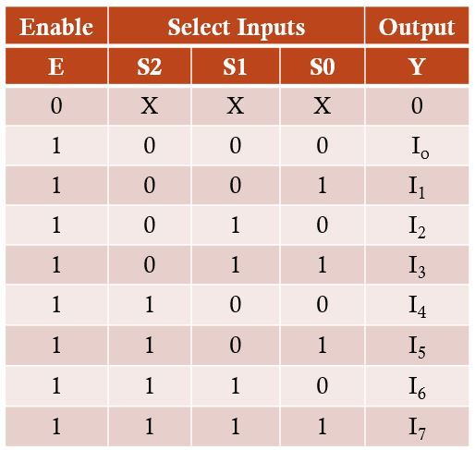
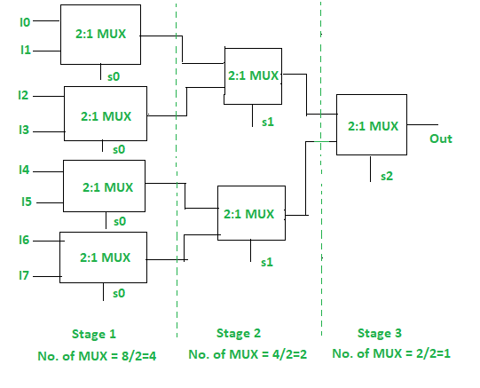
Conventional model of 8X1 multiplexer

Slide 9
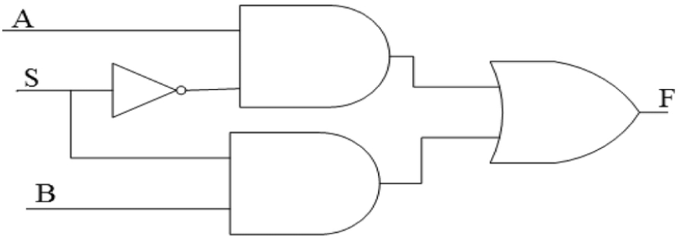
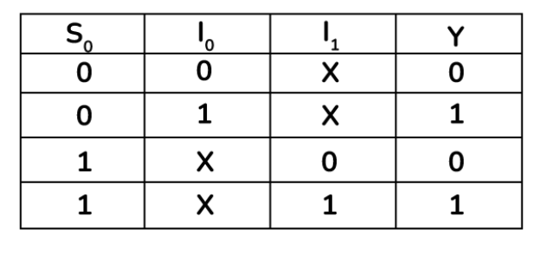
2x1 Multiplexer

Slide 10
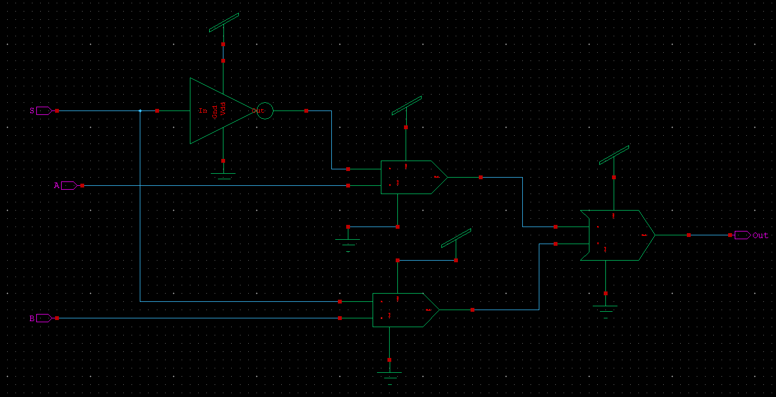
2X1 multiplexer using Static CMOS

Slide 11
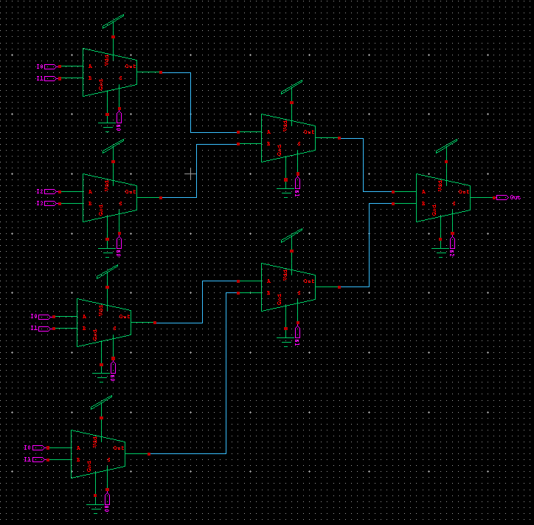
8x1 multiplexer with 2x1 multiplexer using static CMOS

Slide 12
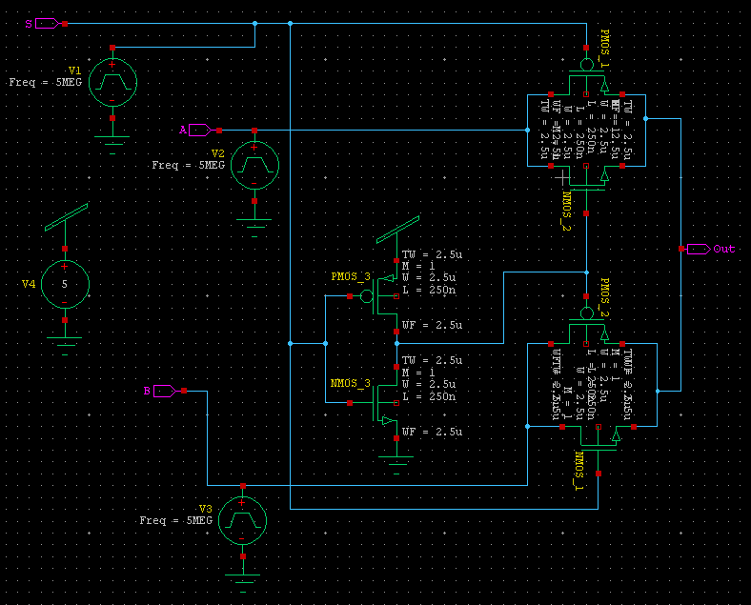
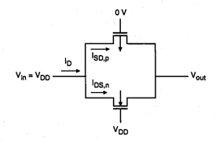
2x1 multiplexer using Transmission Gates
Transmission Gate

Slide 13
8x1 multiplexer with 2x1 multiplexer using transmission gates

Slide 14
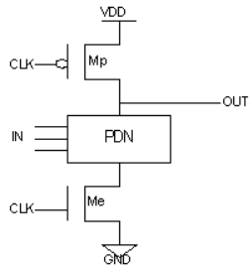
Dynamic Logic

Slide 15
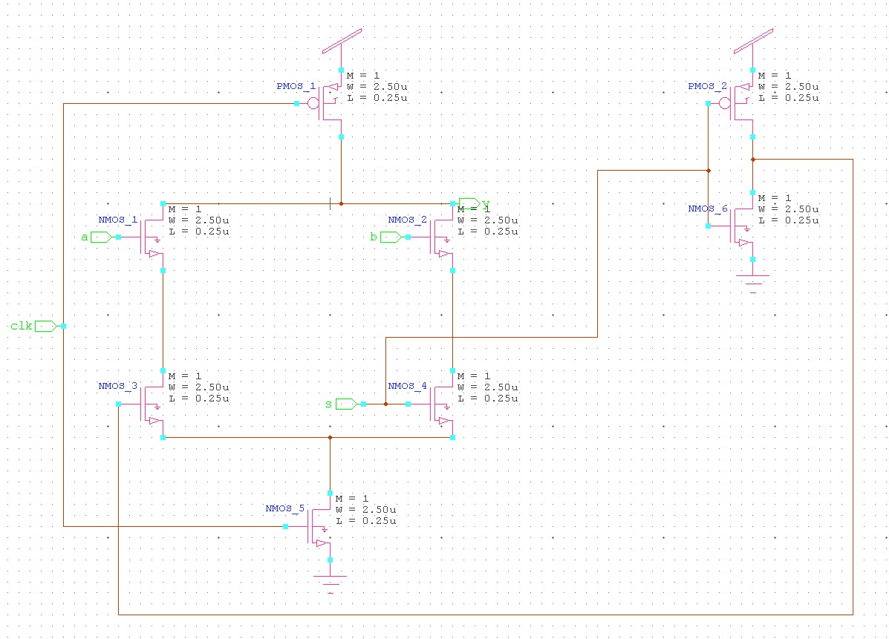
2x1 multiplexer using Dynamic Logic

Slide 16
8x1 multiplexer with 2x1 multiplexer using Dynamic Logic

Slide 17
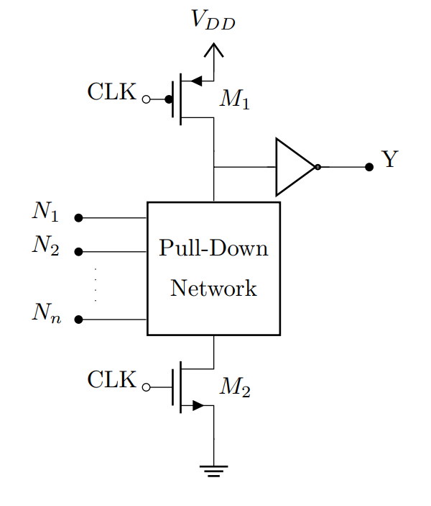
Domino logic

Slide 18
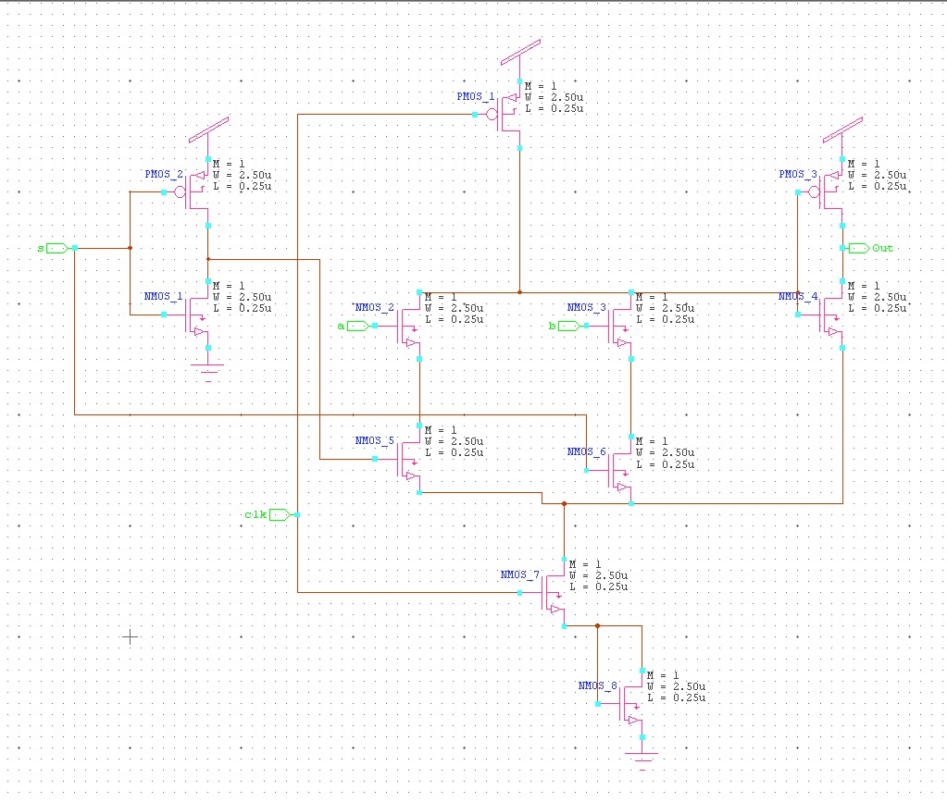
2x1 multiplexer using Domino Logic

Slide 19
8x1 multiplexer with 2x1 multiplexer using Domino Logic

Slide 20
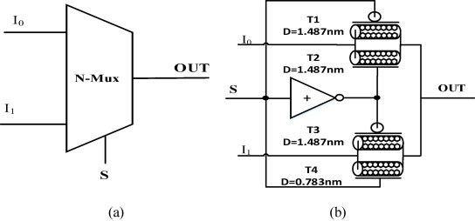
8x1 Multiplexer using CNTFET
2X1 Multiplexer
8x1 multiplexer using 2x1 mux

Slide 21
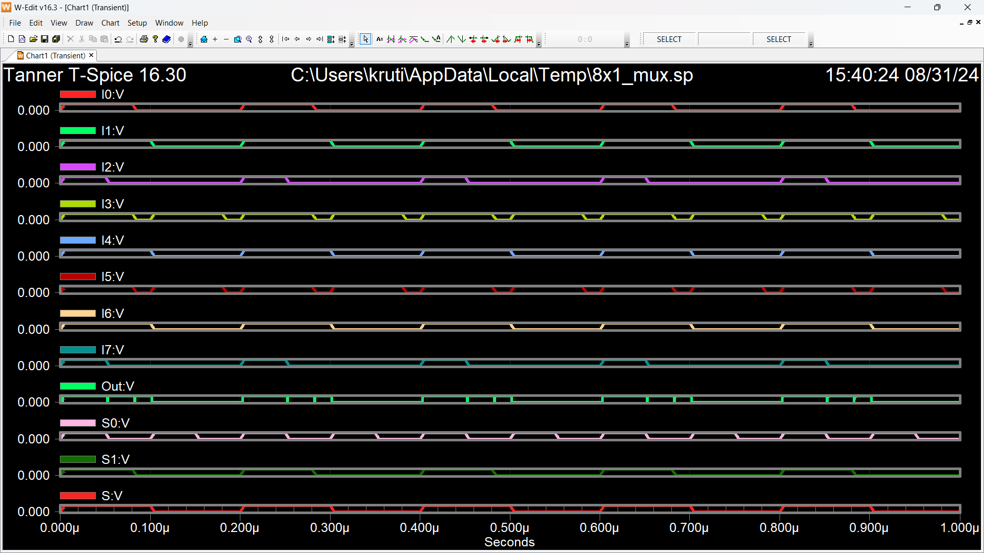
Static CMOS 8X1 Multiplexer Waveform

Slide 22
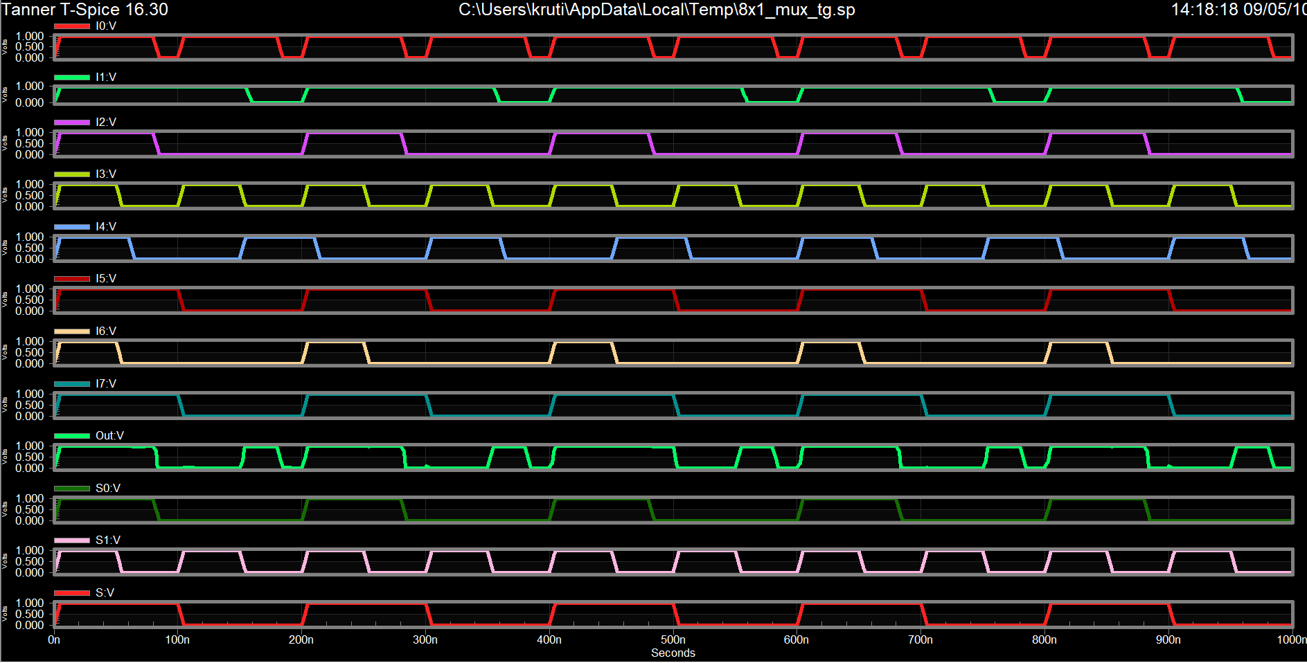
Transmission Gate 8X1 Multiplexer Waveform

Slide 23
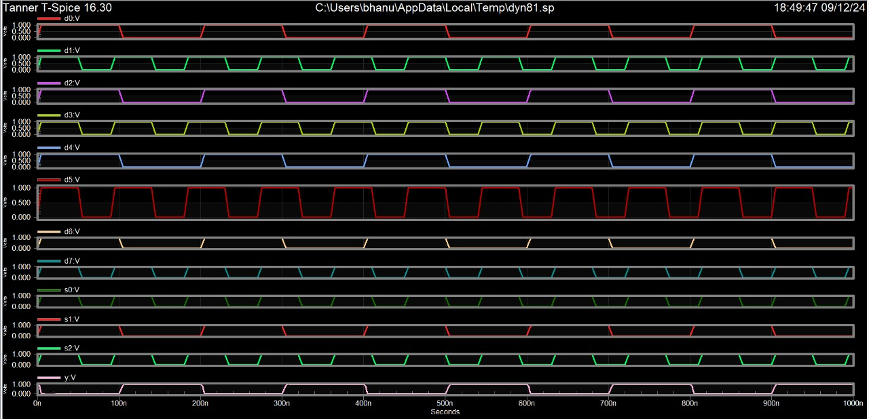
Waveform of 8X1 Multiplexer using dynamic logic

Slide 24
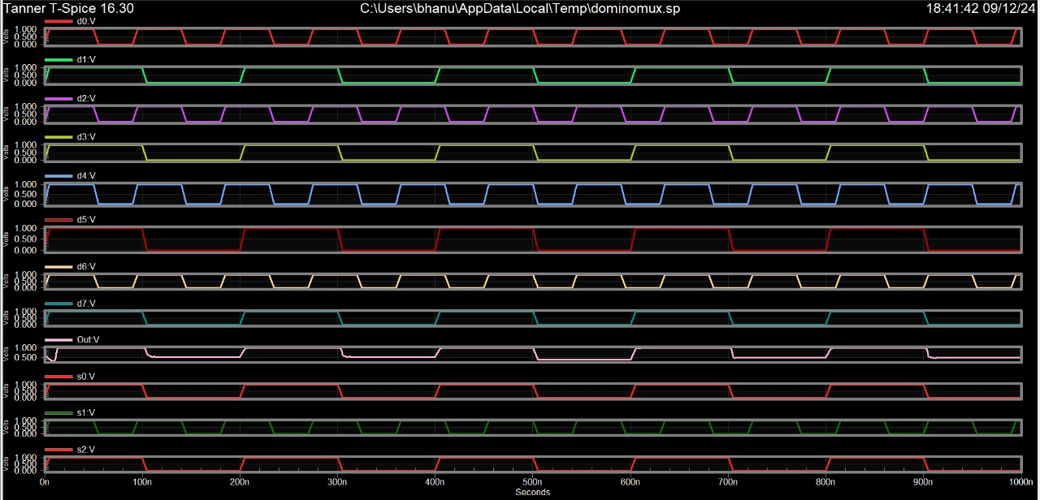
Waveform of 8X1 Multiplexer using Domino logic

Slide 25
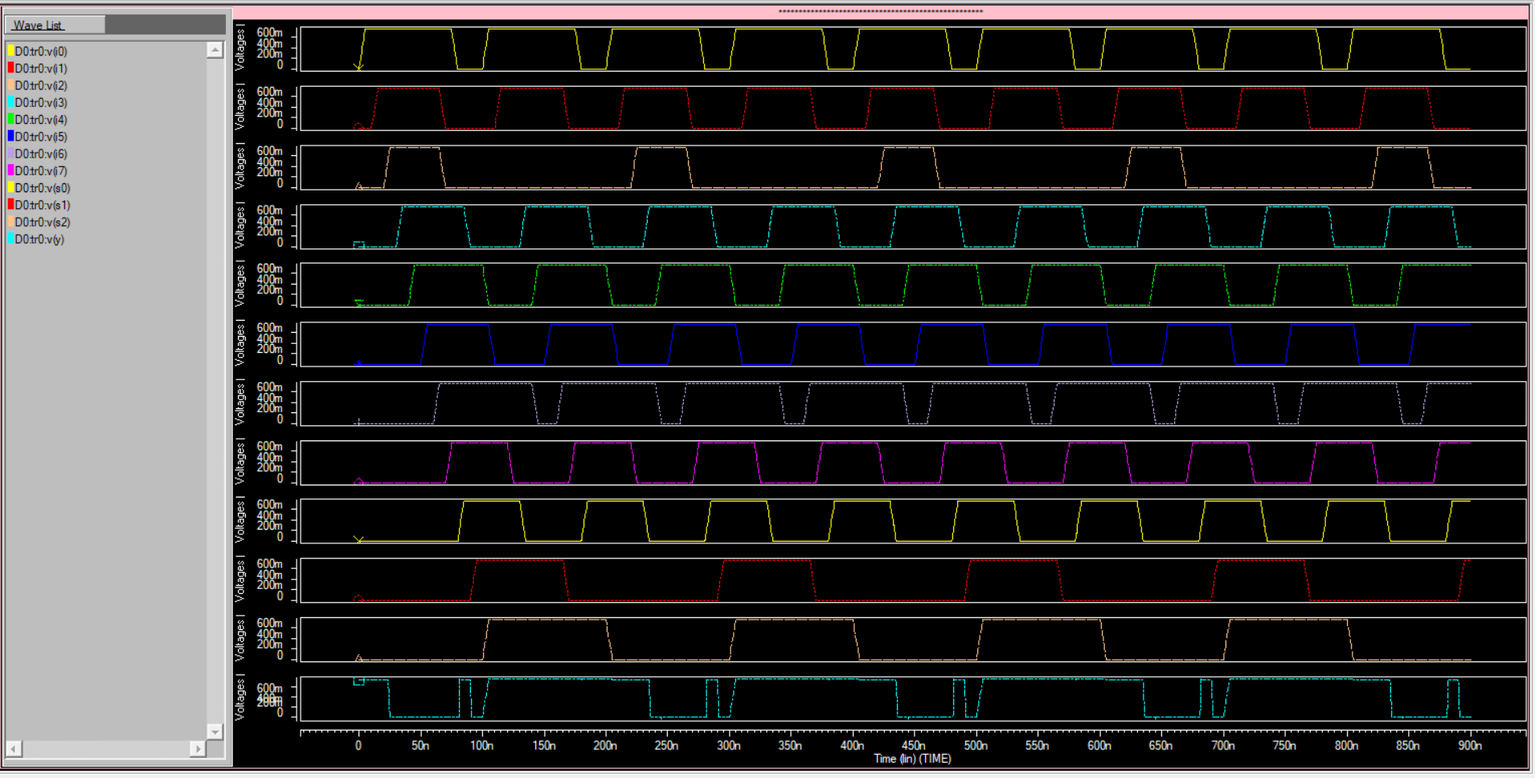
Waveform of 8X1 Multiplexer using CNTFET

Slide 26
Power Analysis
POWER(watt) | CMOS (45nm) | Transmission Gate | Dynamic Logic | Domino Logic | CNTFET
Leakage Power | -6.601u | -2.196u | -900.29n | -762.311n | −22.686n
Dynamic Power | -1.913u | -294.39n | -218.22n | -5.7614n | −22.686n
Static Power | -7.9307u | -1.976u | -1.067u | -793.619n | −45.373n

Slide 27
TIMING ANALYSIS
Time (Seconds) | CMOS (45nm) | Transmission Gate | Dynamic Logic | Domino Logic | CNTFET
Propagation Delay | 458.38n | 176.01n | 100.257n | 8.735n | 7.714n

Slide 28
Conclusion
When analyzing an 8x1 multiplexer with variou logics, several key conclusions can be drawn:
Power Efficiency:
CNTFET technology consistently exhibits lower power consumption across all categories—leakage, dynamic, and static—demonstrating a strong advantage in energy efficiency.
Domino Logic and Transmission Gate Dynamic Logic provide significant improvements over traditional CMOS, particularly in dynamic and static power, though CNTFET remains the most efficient.
2. Delay:
CNTFET technology delivers the fastest propagation delay, underscoring its potential for high-speed, high-performance computing.
Domino Logic and Transmission Gate Dynamic Logic offer improvements over CMOS, making them suitable for applications where speed is crucial but not as demanding as CNTFET-based designs.
CMOS (45nm) lags behind in propagation delay, highlighting the need for newer technologies to meet the demands of high-speed applications.

Slide 29
THANK YOU!

